Slide 1
Computer Organization and Architecture
CST 202
Notes:
1
1

Slide 2
Basic Operational Concepts
Connection Between the Processor and Memory
Program consisting of a list of instructions is stored in the memory.
Individual instructions are brought from the memory into the processor, which executes the specified operations.
Data to be used as operands are also stored in the memory.
Examples: - Add LOCA, R0
This instruction adds the operand at memory location LOCA, to operand in register R0 & places the sum into register.
steps
1. First the instruction is fetched from the memory into the processor.
2.The operand at LOCA is fetched and added to the contents of R0
3.Finally the resulting sum is stored in the register R0
tivity in a computer is governed by instruction. To perform a given task an appropriate program consisting of a list of uctions is stored in the memory. Individual instructions are brought from the memory into the processor, which executes the specified operations. Data to be stored are also stored in the memory.
Examples: - Add LOCA operand at LOCA is fetched and added to the contents of R₀Finally the resulting sum is stored in the register R₀
The preceding add instruction combines a memory access operation with an ALU
Operations. In some other type of computers, these two types of operations are performed by separate instructions for performance reasons.
Load LOCA, R1
Notes:
2

Slide 3
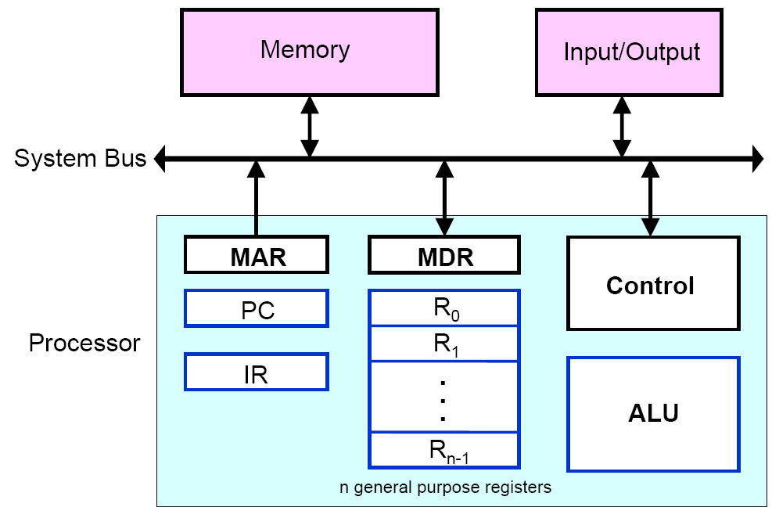
Basic Operational Concepts
Connection Between the Processor and Memory
Notes:
3

Slide 4
Basic Operational Concepts
Connection Between the Processor and Memory
The instruction register (IR):- Holds the instructions that is currently being executed.
The control circuits which generates the timing signals that control the various processing elements involved in executing the instruction.
The program counter(PC): This is another specialized register that keeps track of execution of a program. It contains the memory address of the next instruction to be fetched and executed.
There are n-general purpose registers R0 through Rn-1.
The other two registers which facilitate communication with memory are: -
MAR – (Memory Address Register):- It holds the address of the location to be accessed.
MDR – (Memory Data Register):- It contains the data to be written into or read out of the addressed location.
Notes:
4

Slide 5
Typical Operating Steps (Fetch Cycle)
Programs reside in the memory & usually get these through the I/P unit.
Execution of the program starts when the PC is set to point at the first instruction of the program.
Contents of PC are transferred to MAR and a Read Control Signal is sent to the memory.
After the time required to access the memory elapses, the addressed word is read out of the memory and loaded into the MDR.
Now contents of MDR are transferred to the IR & now the instruction is ready to be decoded and executed.
If the instruction involves an operation by the ALU, it is necessary to obtain the required operands.

Slide 6
Typical Operating Steps (Fetch Cycle)
6. When the operand has been read from the memory to the MDR, it is transferred from MDR to the ALU.
7. After one or two such repeated cycles, the ALU can perform the desired operation.
8. If the result of this operation is to be stored in the memory, the result is sent to MDR.
9. Address of location where the result is stored is sent to MAR & a write cycle is initiated.
10.The contents of PC are incremented so that PC points to the next instruction that is to be executed.

